Slide 1


Tapestry Childhood Education Platform

Slide 2

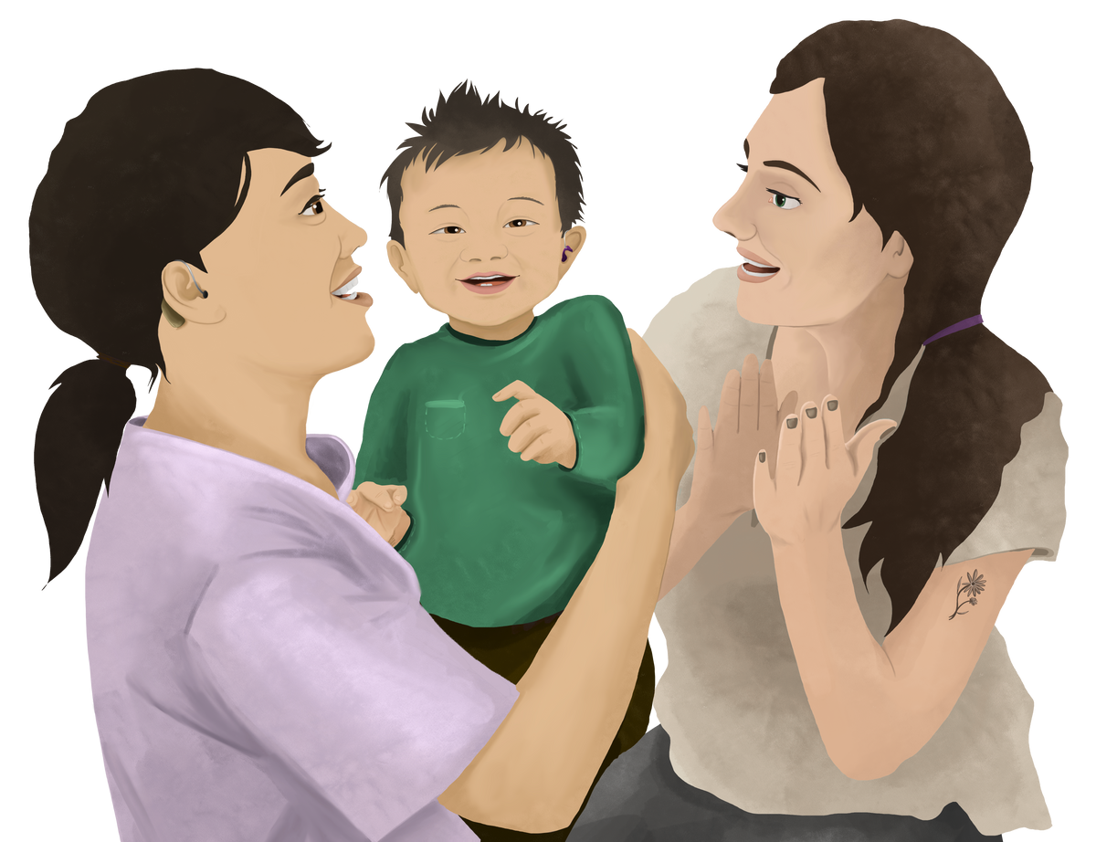
A note for settings, childminders and schools
We have designed this presentation to help you introduce Tapestry to the parents and carers in your community. It makes some assumptions about what you will be using Tapestry for. Please feel free to change or remove any slides that do not apply to your particular set-up.
If you have any questions or would like to add more information, you can contact us at customer.service@eyfs.info
The Tapestry Team
P.S: Don’t forget to delete this slide!

Slide 3
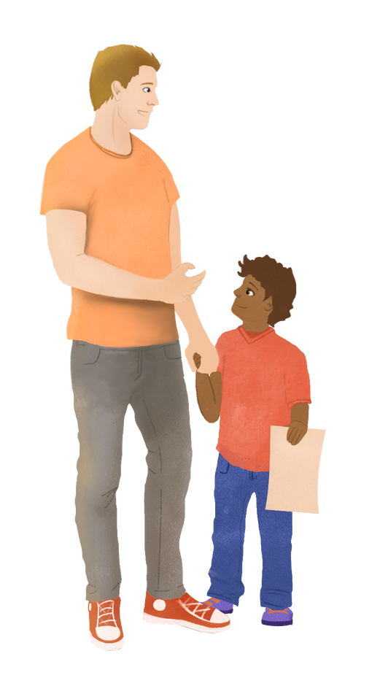
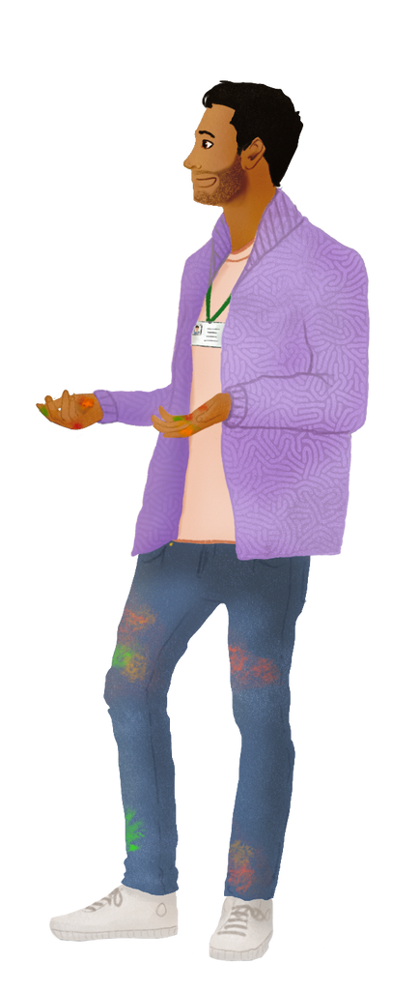
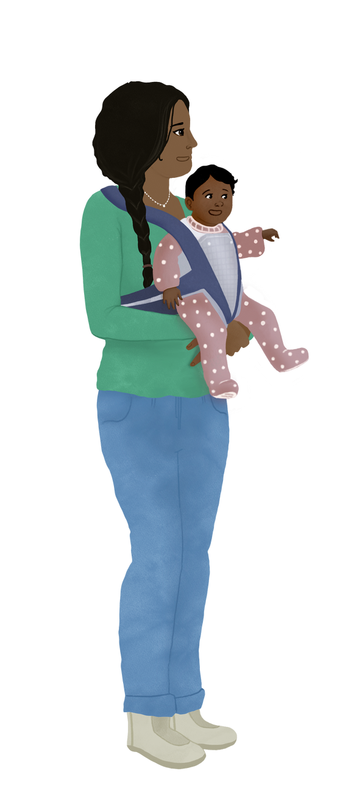
What is Tapestry Childhood Education Platform?
Tapestry is an online system that supports us with:
  Documenting and celebrating each child's unique learning and development
  Working in partnership with families and carers
  Developing a child-centred approach to planning and assessment
  Nursery management processes, with booking, invoicing and in-app attendance registers
  Supporting our staff to elevate our provision

Slide 4
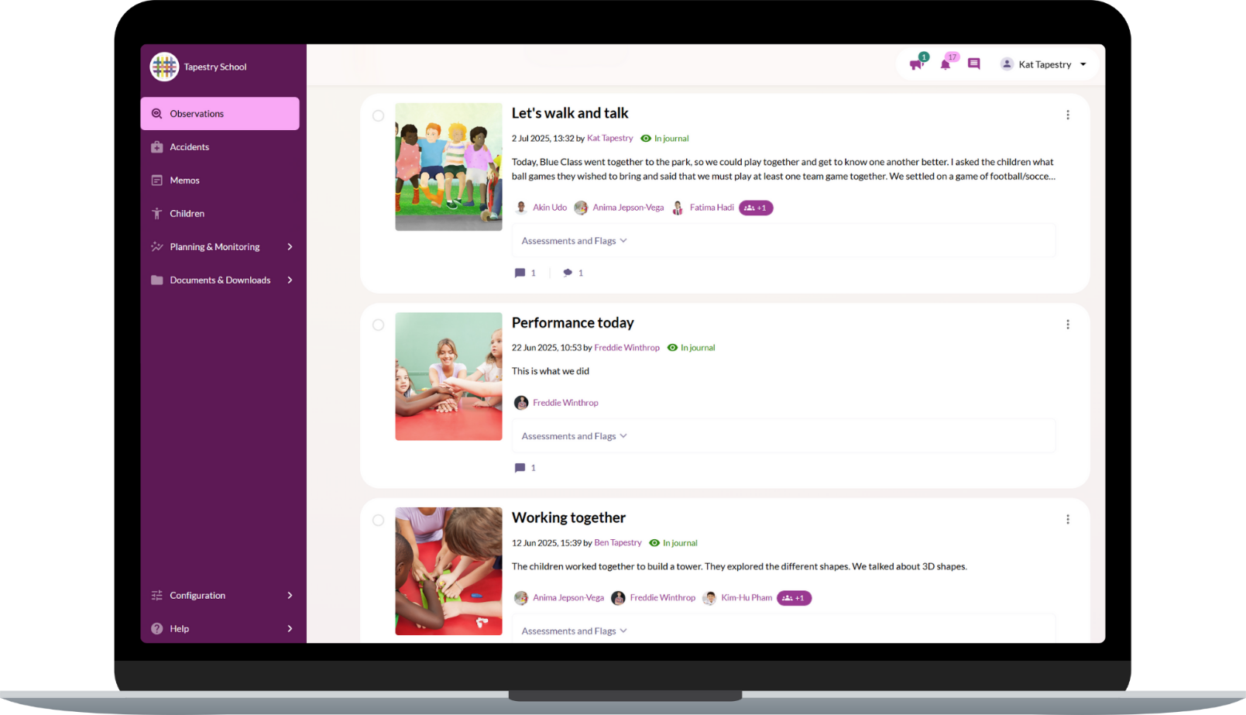
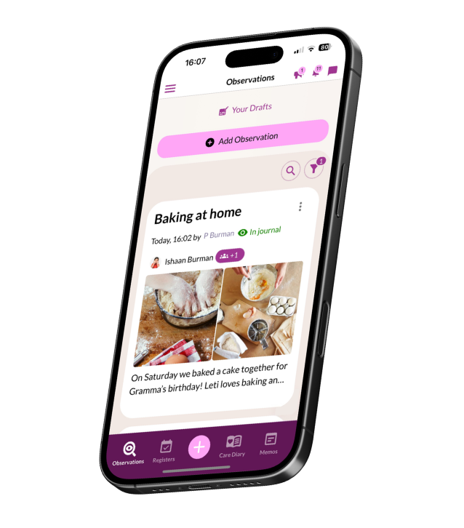
Documenting children’s learning and development
Each child will have their own learning journal on Tapestry so we can:
  Follow your child’s learning and development
  Plan experiences to help them to make progress
Through the journal we will share ‘observations’ and daily care logs with you.
You will also be able to use Tapestry to add pictures and videos of the things you do together at home or out and about. These will help us get to know your child better.

Slide 5
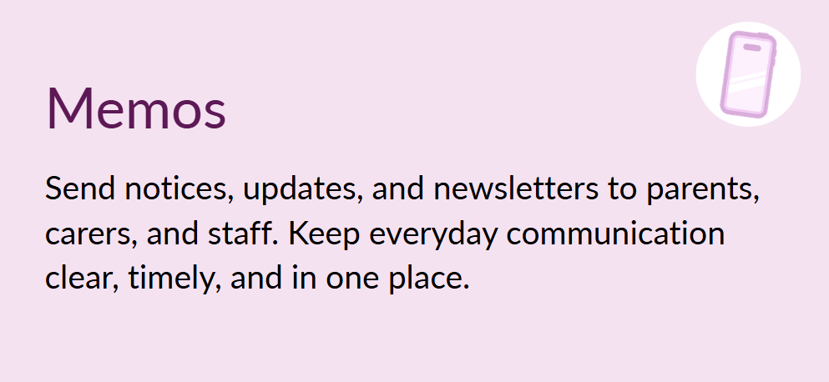
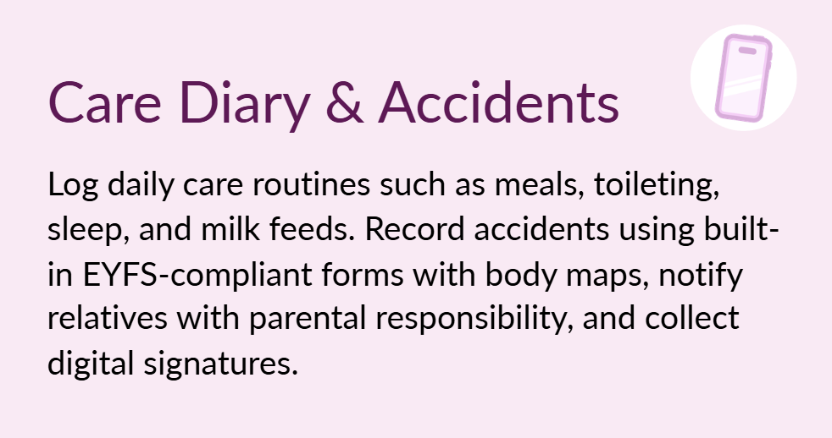
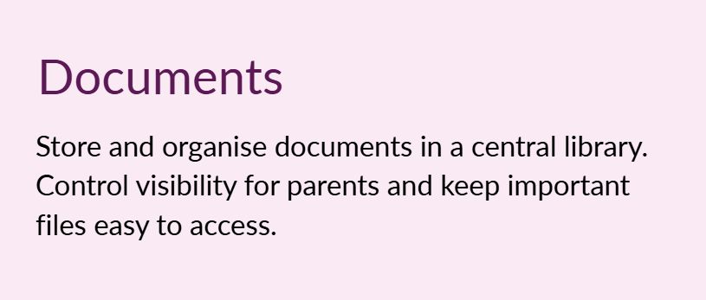
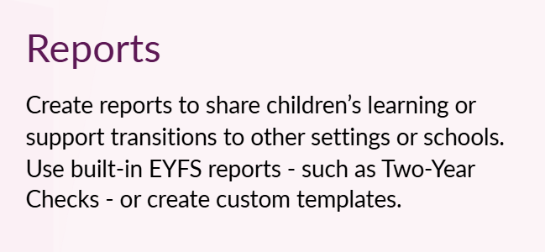
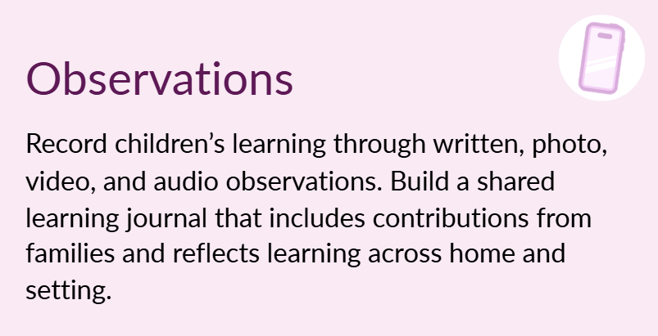

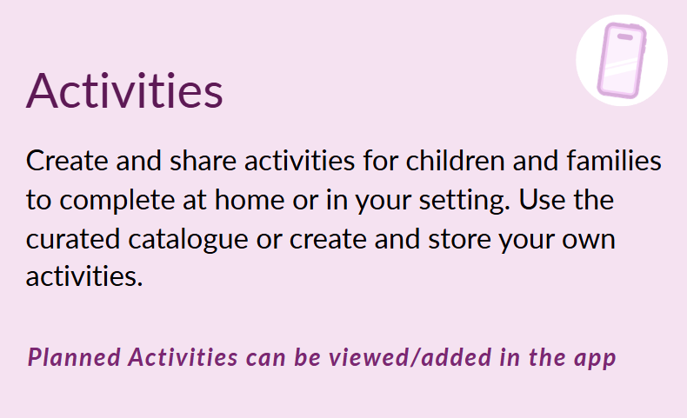
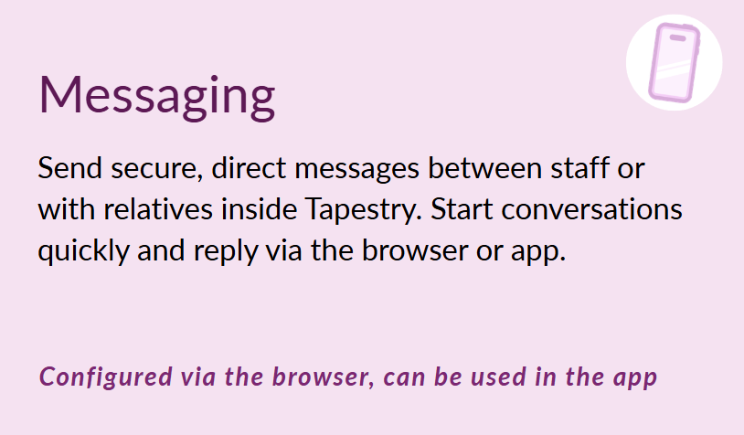
Working in partnerships with families
Tapestry helps us to communicate with the families in our community, and to build stronger relationships with you.

Slide 6
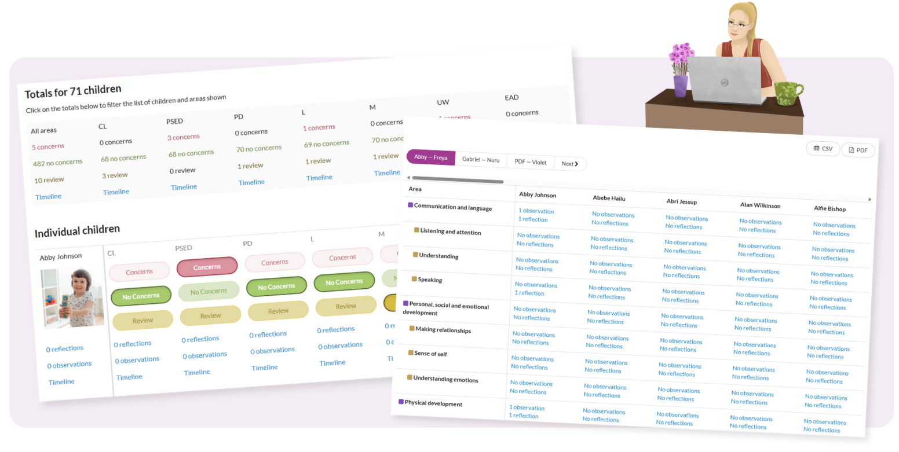
Developing a child-centred approach to planning and assessment (EYFS)
Tapestry provides our staff and leadership team with an overview of each child, so we can monitor, support and celebrate your child’s progress.
In Early Years, we use:
  EYFS framework
  Birth to 5 Matters
  Our own curriculum

Slide 7
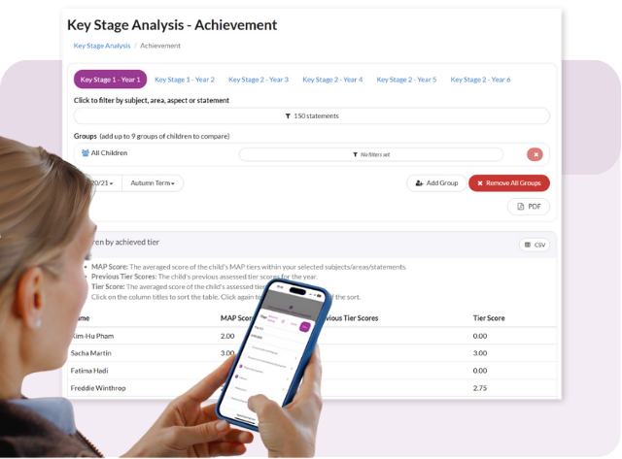
Developing a child-centred approach to planning and assessment (KS1 and 2)
Tapestry provides our staff and leadership team with an overview of each child, so we can monitor, support and celebrate your child’s progress.
In Key Stage 1 and 2, we use:
  The National Curriculum
  Our own sequenced curriculum (e.g. PE, Art, History, RE, etc)

Slide 8
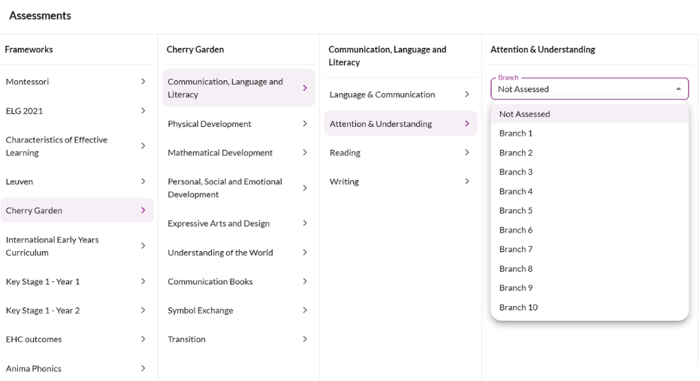
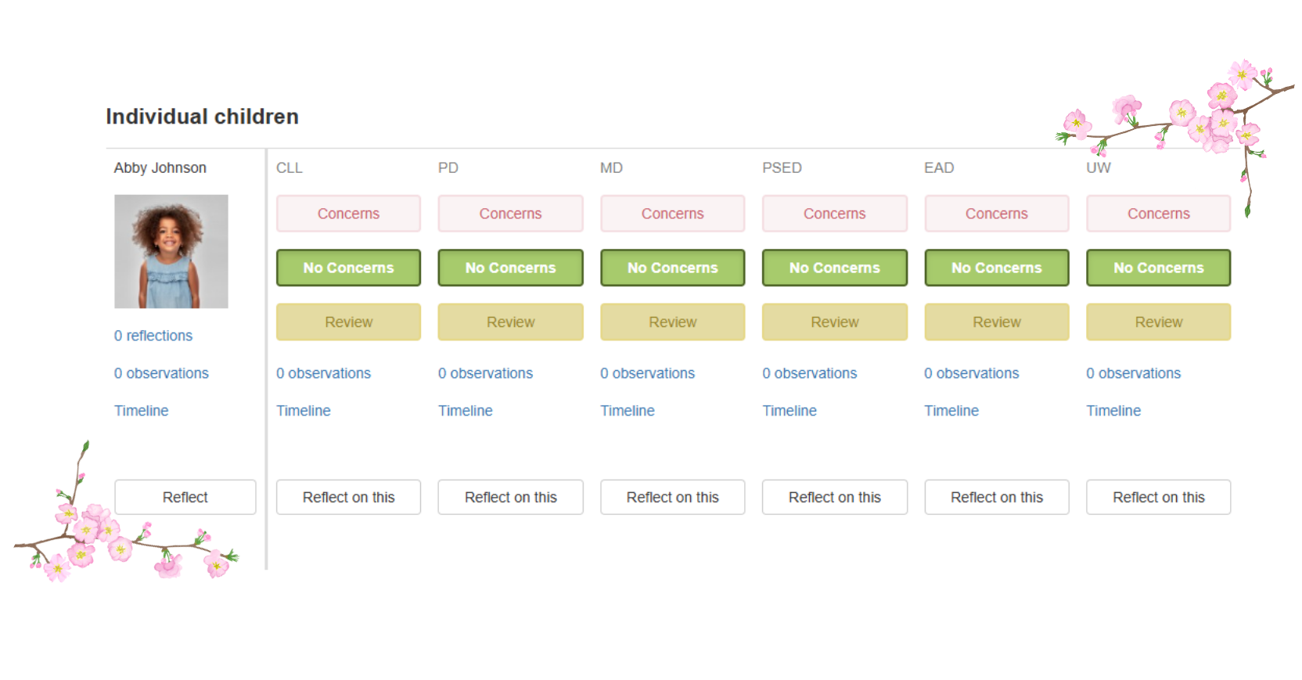
Developing a child-centred approach to planning and assessment (SEND)
Tapestry provides our staff and leadership team with an overview of each child, so we can monitor, support and celebrate your child’s progress.
For our children with SEND, we use:
  EYFS framework
  Birth to 5 Matters
  The National Curriculum
  Cherry Garden Branch Maps
  Our own curriculum

Slide 9
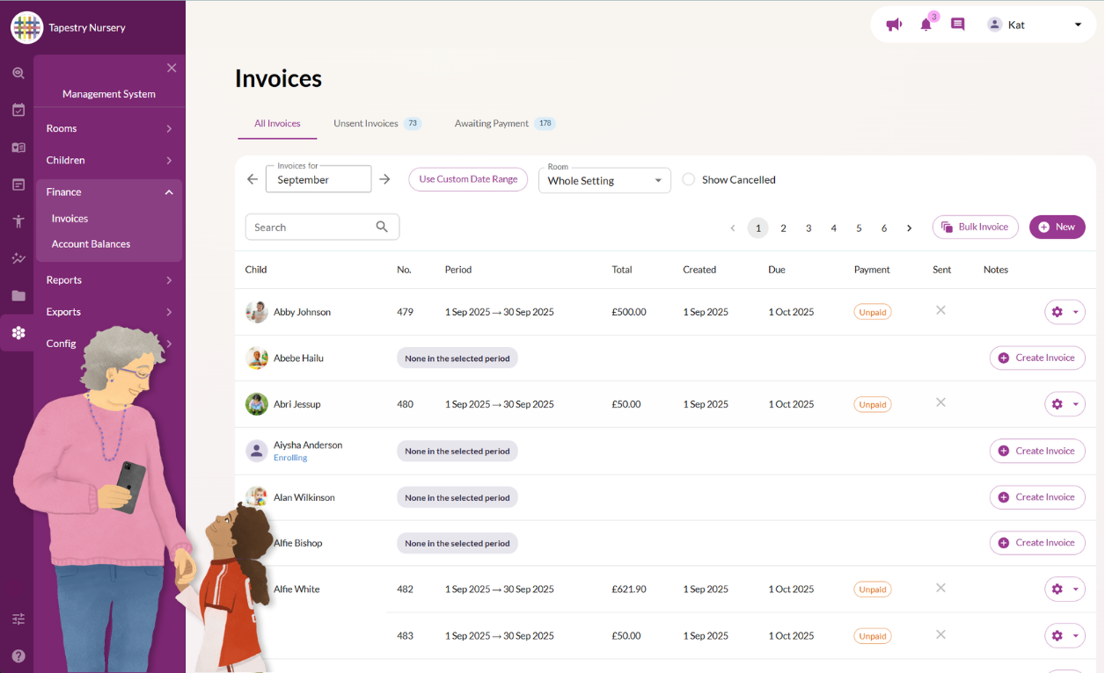
Supporting management systems
Tapestry also provides a management system for us to:
  Book your child’s regular schedule and ad hoc sessions
  Apply funded hours
  Add extra consumables
  Sign them in and out
  Record and consult their pick up password
  Send you clearly itemised invoices
  Send you Universal Credit-compliant invoices and payment receipts
Relatives will be able to access and view their invoices and account balances directly in Tapestry.

Slide 10
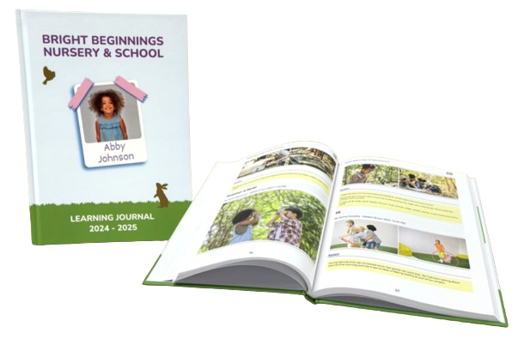
PDF and professionally printed journals
At the end of your child’s time with us, we will provide you with a PDF copy of their journal. You can also export a PDF copy yourself whenever you like.
You also have the option to purchase a professionally printed book version through publisher Group Hugs.
The PDF (and printed) journal will include all the observations in your child’s journal, made by both us and you. This is a lovely keepsake of your child’s experiences.

Slide 11
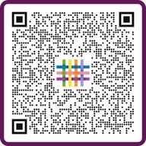

Security
For more information on how Tapestry keeps data safe visit their website: tapestry.info/security/
Data security is Tapestry’s highest priority.
  Comprehensive contracts and data processing agreements that prioritise the safety of your information
  Set and enforce password strength requirements for all staff ad relative accounts
  Two-factor authentication (2FA) is available to add a vital extra layer of security to user logins
  You decide exactly what each user can see and do within the system
  We are Cyber Essentials certified
Data security is Tapestry’s highest priority.
  Comprehensive contracts and data processing agreements that prioritise the safety of your information
  Set and enforce password strength requirements for all staff ad relative accounts
  Two-factor authentication (2FA) is available to add a vital extra layer of security to user logins
  You decide exactly what each user can see and do within the system
  We are Cyber Essentials certified
SCAN ME

Slide 12
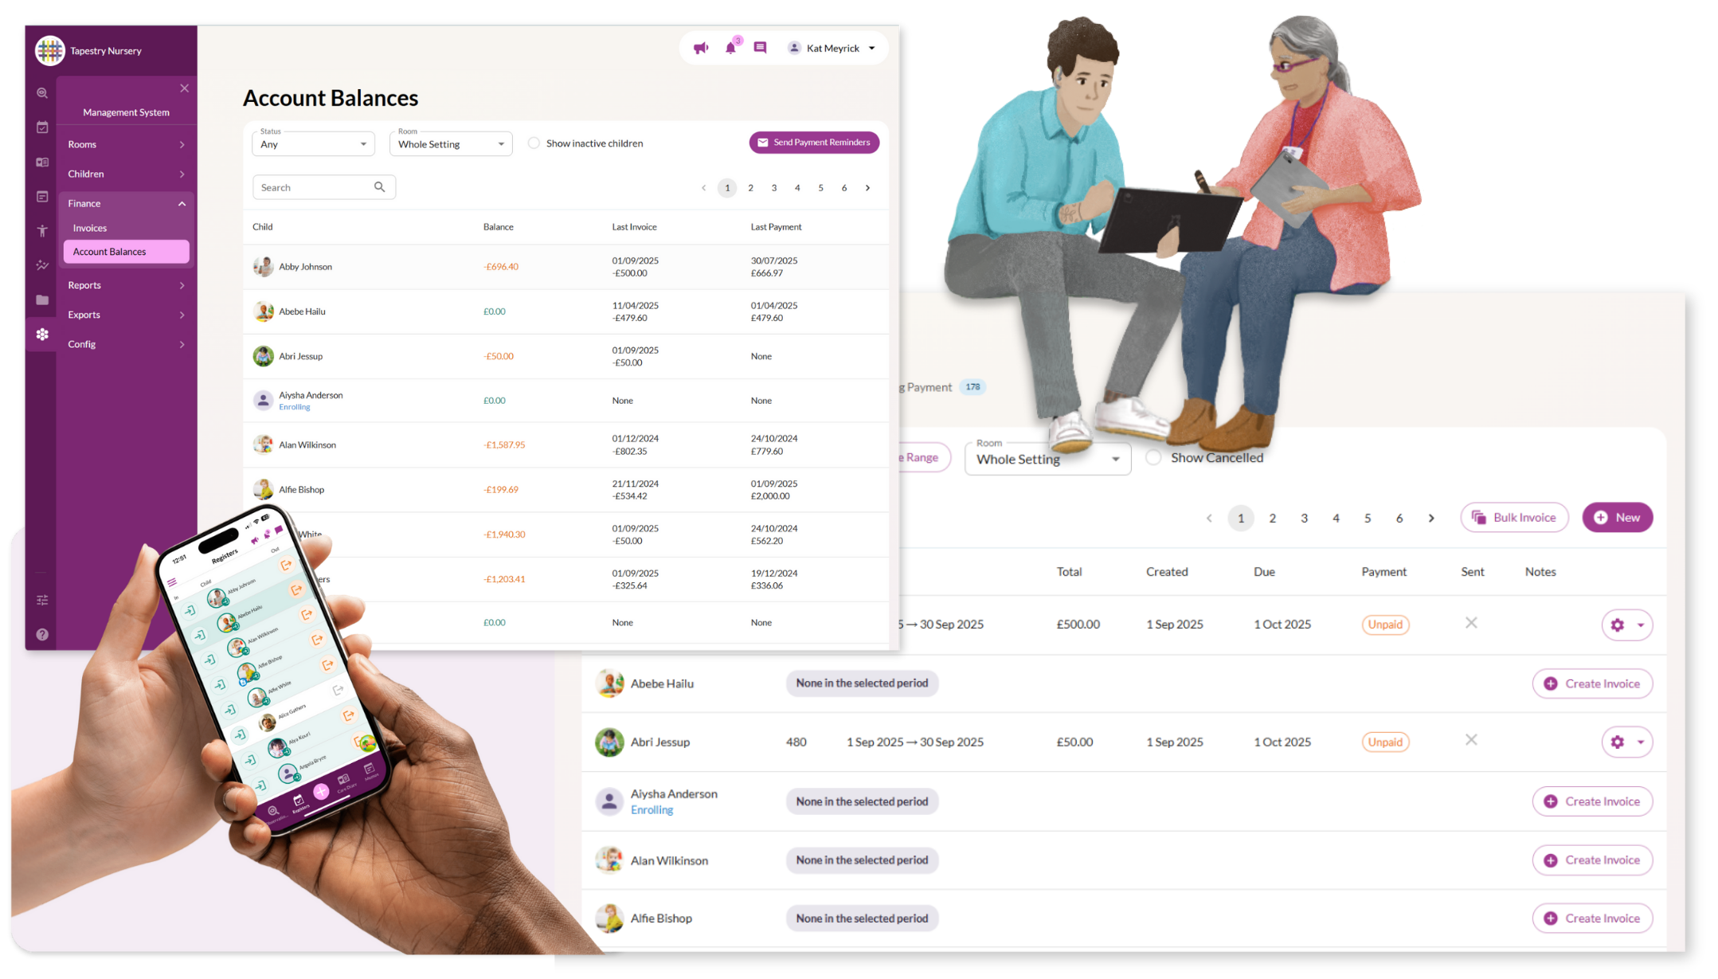



How to access Tapestry
Tapestry is accessible both from a browser (e.g. Chrome, Firefox, etc) via tapestryjournal.com, and an app, available to download for iOS and Android.

Slide 13
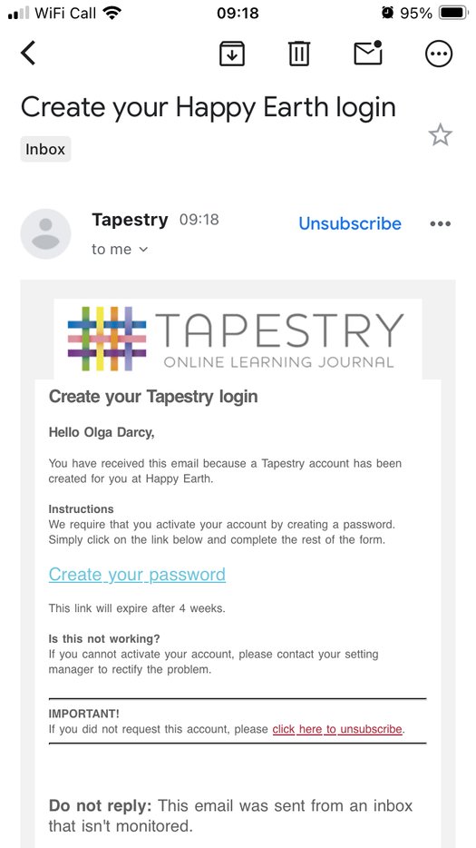
How to access Tapestry
Once we have your signed consent forms, we will set you up with your profile.
  You will use this profile to view and contribute to your child’s journal.
  You will receive an email with an activation link to activate your Tapestry profile - don’t forget to check your spam!
  You will need to choose a password. You can use this to log in to both the Tapestry app and the desktop version.
  You will also be able to set up a 4-digit PIN to quickly log in to the app.

Slide 14
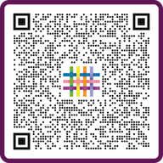
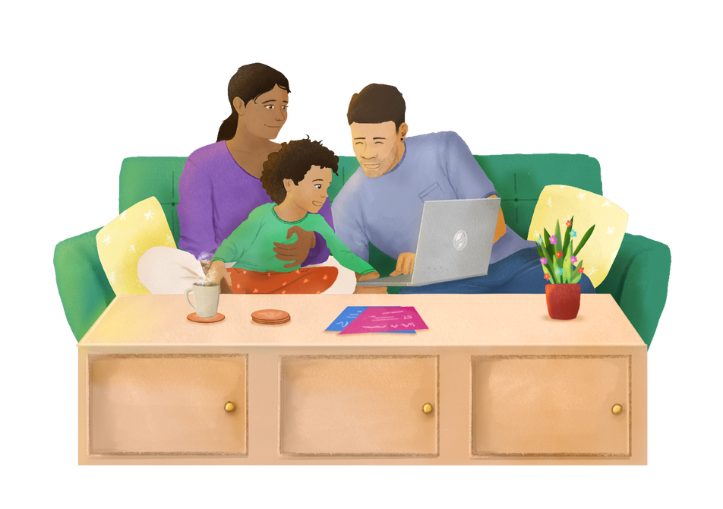
Further information
Visit the Parents & Carers section on Tapestry’s website for more information and FAQs: tapestry.info/parents-carers/
SCAN ME

Slide 15
Tapestry Childhood Education Platform

